Slide 1
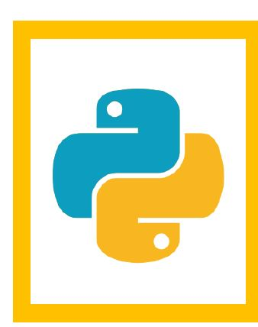
Python Basics

Slide 2
Today Agenda
Variables, Types
User Input
Math Functions
Sequence Objects
Lists
Strings
Dictionaries
Tuples
Control Structures
Indexing
Slicing
Functions
Numpy Arrays

Slide 3
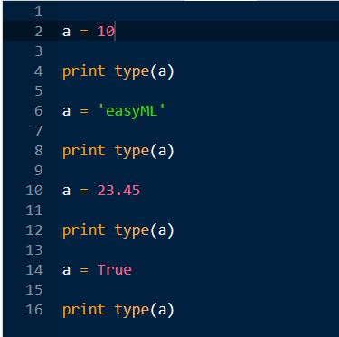
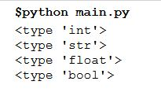
Variables, Types
No need to declare but need to initialize.
Python is a dynamically-typed language.
Case-sensitive.

Slide 4
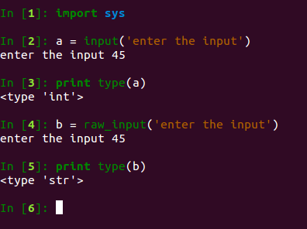
User Input
import library is sys.
n = input("Enter a number:") # numeric input
name = raw_input("Enter your name:") # string input

Slide 5
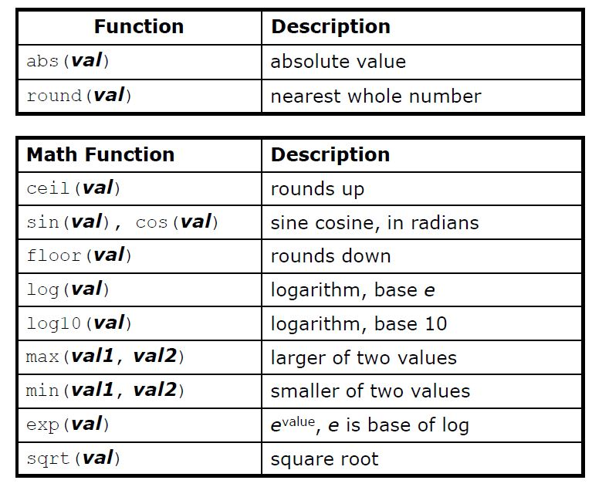
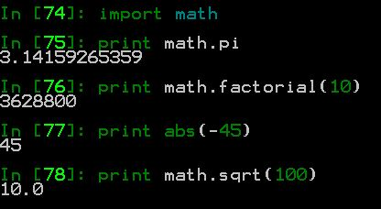
Math Functions

Slide 6
Sequence Objects
Positionally ordered set of objects.
Notion of left-to-right ordering.
Mutable vs Immutable sequences
Some Built-in Objects
Strings
Lists
Tuples
Dictionaries #unordered mapping type
Sets #unordered collection

Slide 7
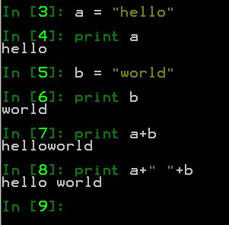
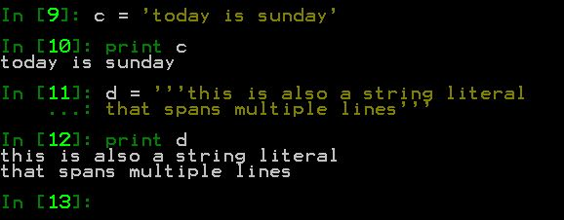
Sequence Objects (Strings)
Sequence of bytes or characters.
e.g gene sequence, database records, text , etc
No char type in Python

Slide 8
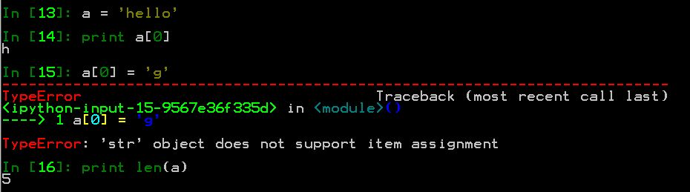
Sequence Objects (Strings)
Strings are immutable.

Slide 9
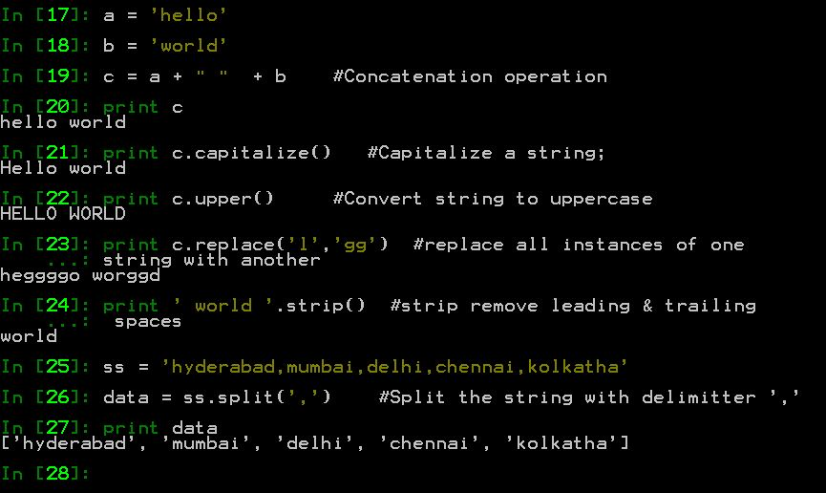
Sequence Objects (Strings)
Some of the string operations.

Slide 10
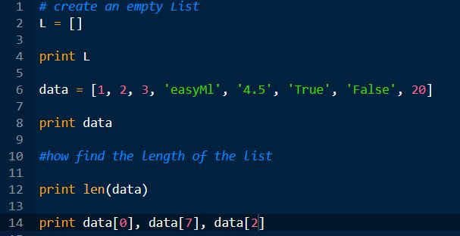
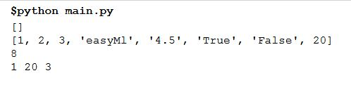
Lists
Mutable ordered-collection of arbitrary objects inside `[ ]'.
Offset-based access.

Slide 11
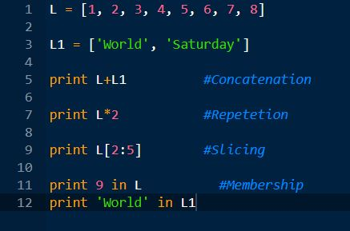
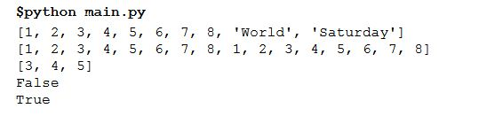
List Operations
Concatenation (+)
Repetition (*)
Slicing
Membership

Slide 12
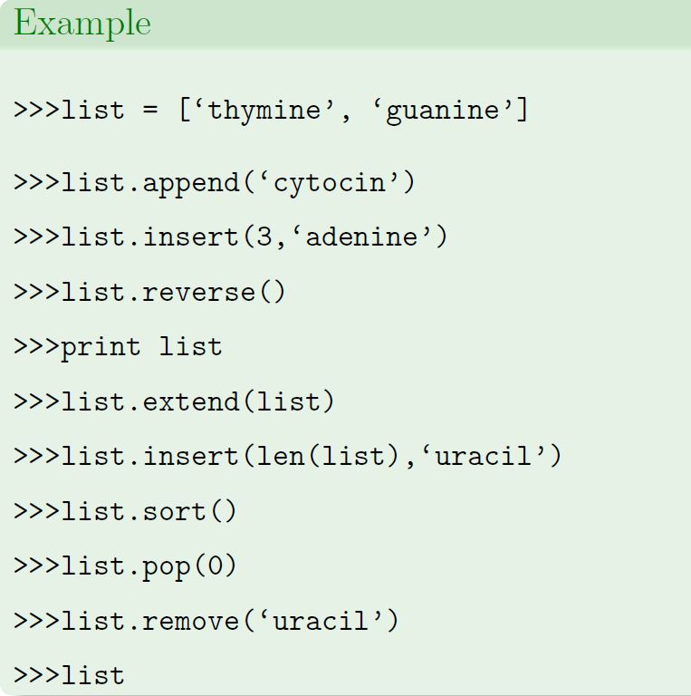
List Methods

Slide 13
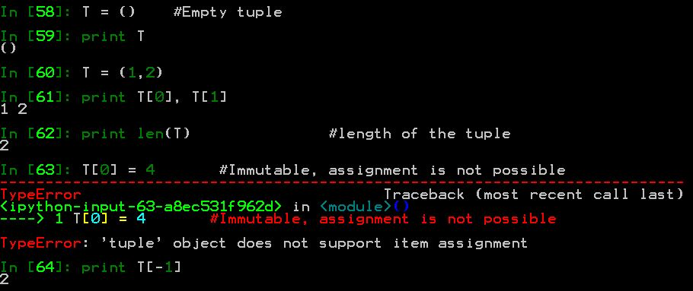
Tuples
Ordered set of items inside ().
Are immutable sequences, fixed-size.

Slide 14
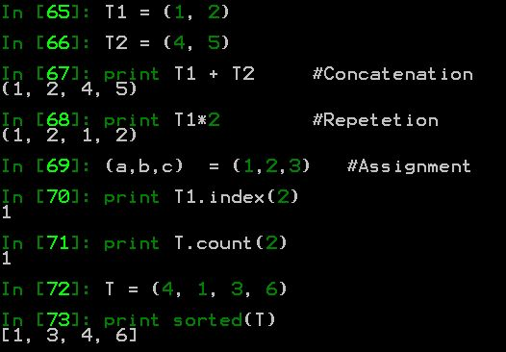
Tuple Operations

Slide 15
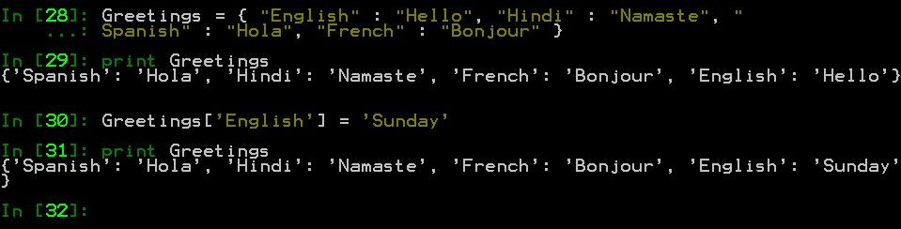
Dictionaries
Unordered Containers.
Mapping objects that map/bind keys to values.
dict = { key1:value1, key2:value2, key3:value3... }
i.e. set of unordered key-value pairs.
Key-based access, and not positional.
Mutable
Mutable

Slide 16
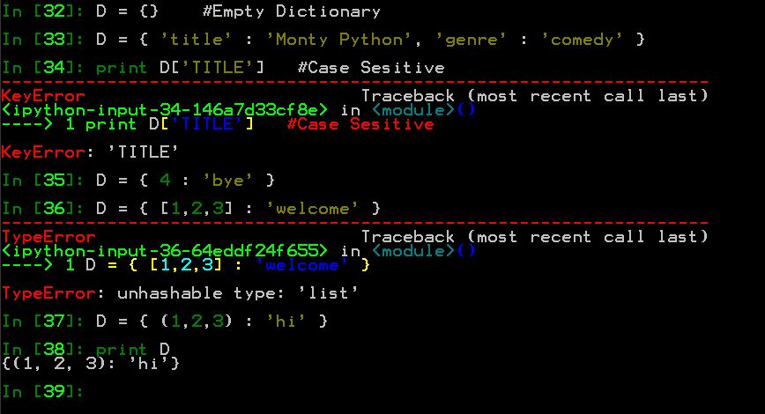
Dictionaries Operations
Construction

Slide 17
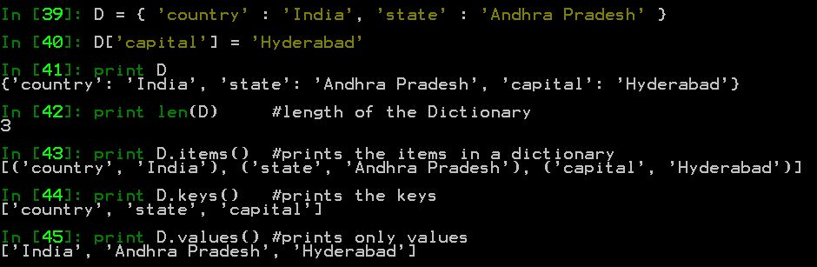
Dictionary Methods

Slide 18
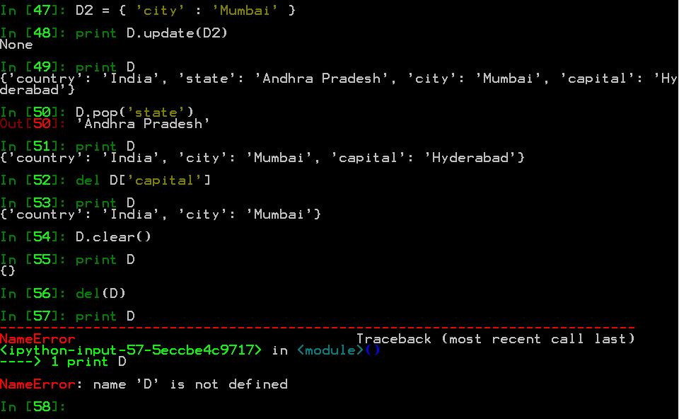
Dictionary Methods

Slide 19
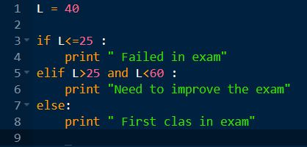

Control Structures
Structuring is through indentation. Welcome to Python :)
New line signals end of statement; semicolon separates statements.
Bracketed code can span multiple lines. Alternatively, use `\'.
True any non-zero or non-empty objects.
False zero, empty object, or None.
If Statetement

Slide 20
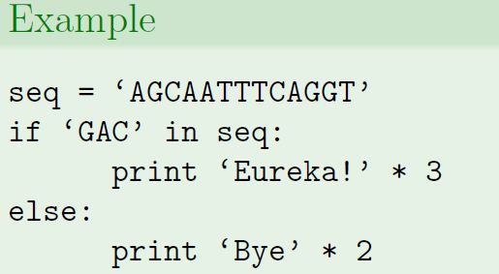
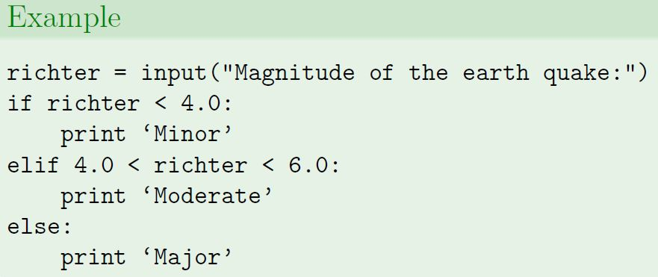
Flow Control – if Loop

Slide 21

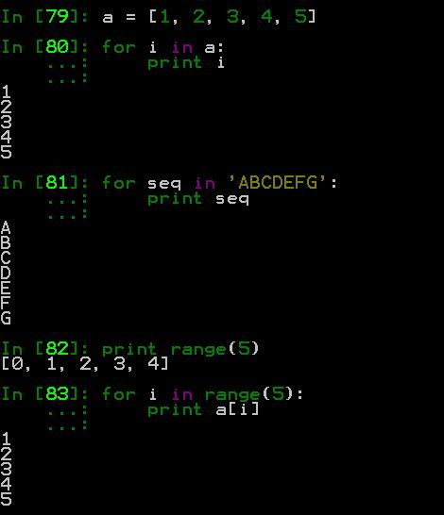
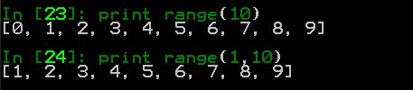
Flow Control – for Loop
Be indented! Mind the colons.
<sequence object> can be strings, lists, tuples & dictionaries.

Slide 22
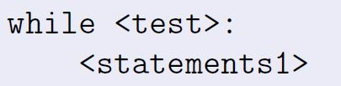
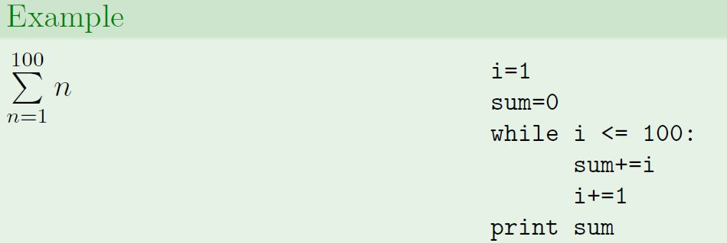
Flow Control – while Loop

Slide 23
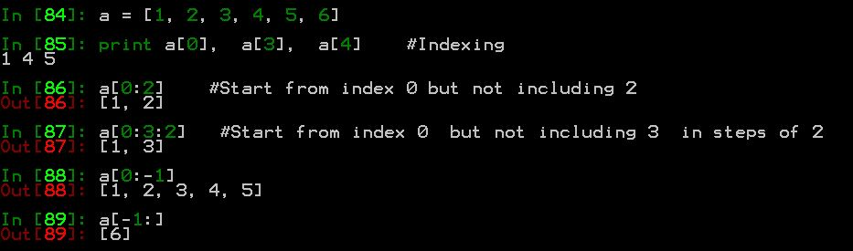
Slicing & Indexing
Indices start from 0
Negative Indices
Slicing allows to cut out a range of indices.

Slide 24

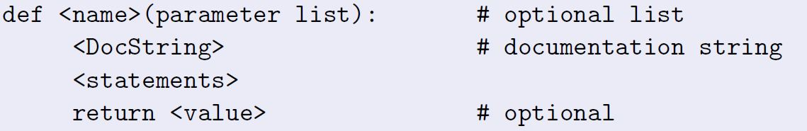
Functions
So far, some built-in functions:
len(), abs(), int(), append(), etc
Why functions?
Maximize code reuse
Minimize code redundancy
Code readability
Easy debugging, etc

Slide 25
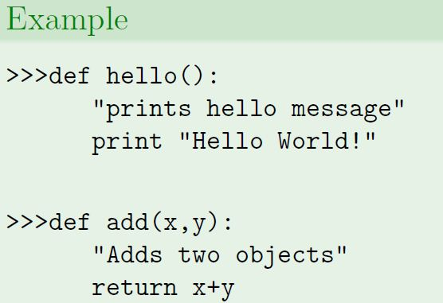
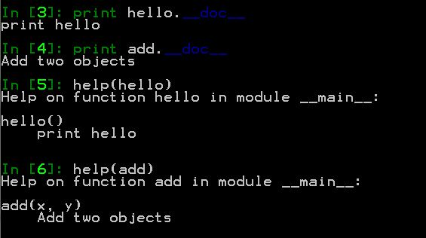
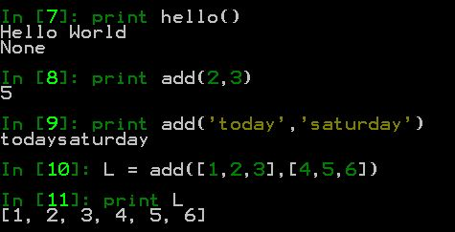
Functions

Slide 26
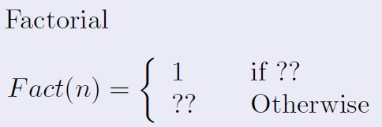
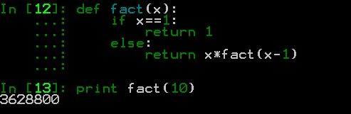
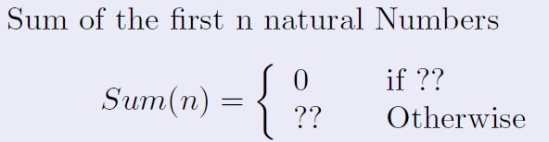
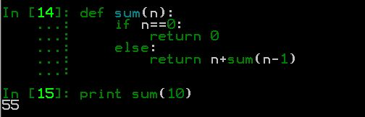
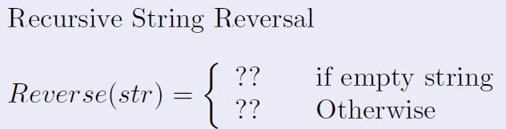
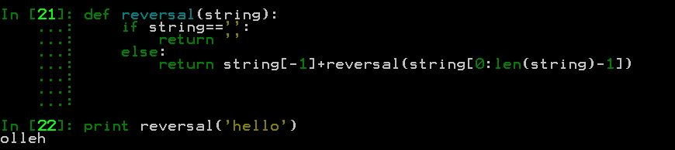
Functions Examples

Slide 27
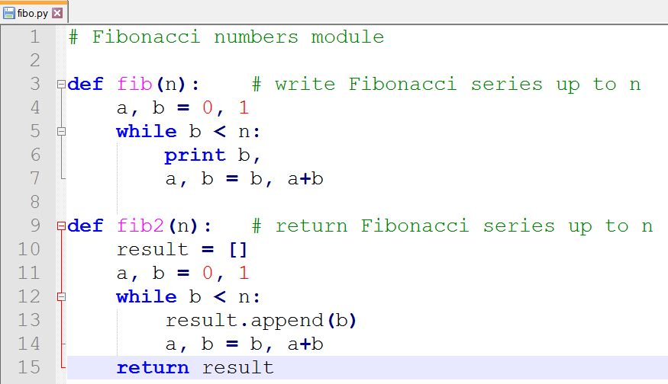
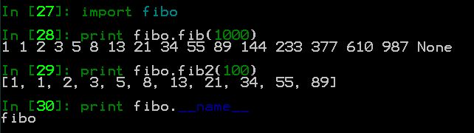
Modules
A module is a file containing Python definitions and statements.

Slide 28
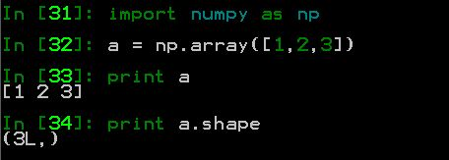

Numpy – Python Library
Numpy is the core library for scientific computing in Python.
It provides a high-performance multidimensional array object, and tools for working with these arrays.
Aliasing (as)
Provide Dimension

Slide 29
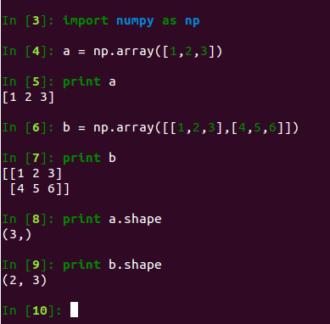
Array creation using Numpy
Python does not have arrays as a native type.
Definition and usage is similar to lists.
Can have multidimensional arrays.
easyML
Vector
Matrix

Slide 30
Python Lists vs Numpy
A common beginner question is what is the real difference between Lists and Numpy.
The answer is performance.
Numpy data structures perform better in:
Size - Numpy data structures take up less space
Performance - they have a need for speed and are faster than lists
Functionality - SciPy and NumPy have optimized functions such as linear algebra operations built in.

Slide 31
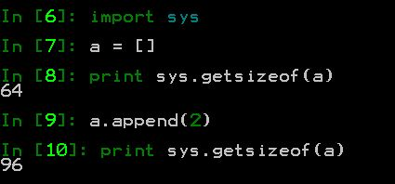
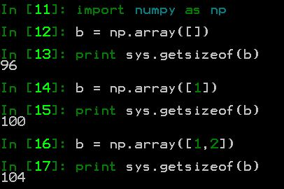
Python Lists vs Numpy
In case of Python Lists - for every new element,
We need another eight bytes for the reference to the new object.
The new integer object itself consumes 24 bytes.
The size of a list can be calculated as: 64 + 8 * len(list) + len(list) * 24
NumPy takes up less space.
This means that an arbitrary integer array of length "n" in numpy needs - 96 + n * 4 Bytes

Slide 32
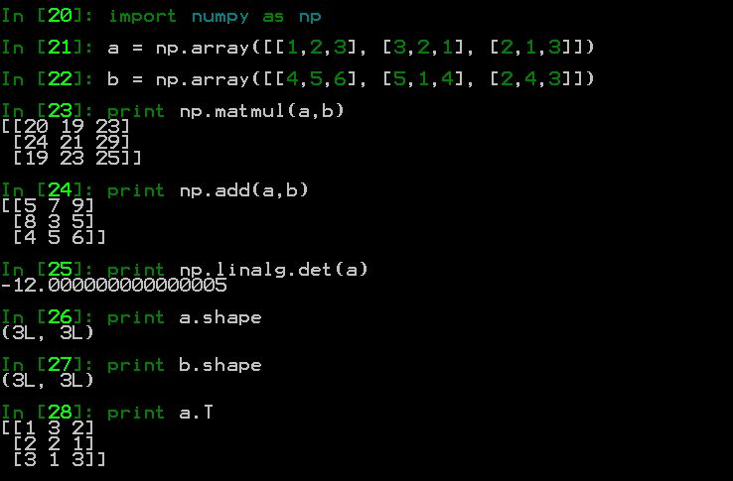
Matrix Operations
Matrix multiplication
Matrix addition
Determinant of a matrix
Dimension of a matrix
Transpose of a matrix

Slide 33
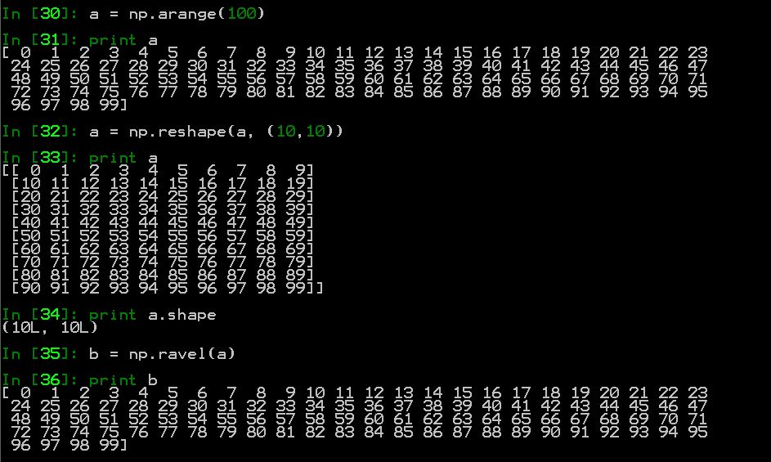
Numpy methods
np.arange()
np.reshape()
np.ravel()

Slide 34
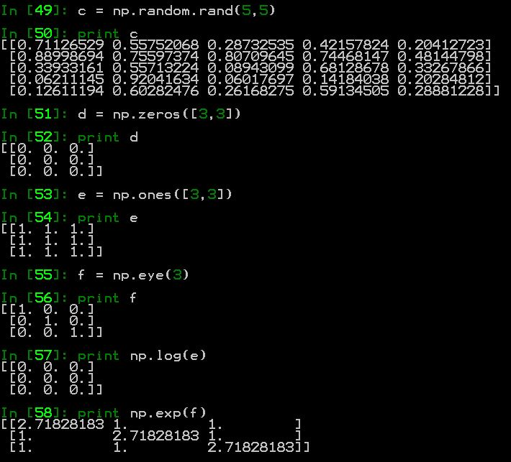
Numpy methods
Random matrix
Zero matrix
Ones matrix
Identity matrix
Log of a matrix
Exp of a matrix

